Slide 1
AUTONOMOUS FIXED WING UAV
(Unmanned aerial Vehicle)
NAME : ADESH GREWAL
PARAS NAITHANI
ROLL NO. : UE189005
UE189055

Slide 2
Our Aim:
Our aim is to create a functional fixed wing autonomous UAV that can be controlled and send live visual feedback.
Our focus is to construct an autonomous fixed wing UAV system based on the matek microcontroller system focusing towards land surveillance. e.g such as monitoring flood-prone areas, recording video images from impassable areas as well as military and non-military security work.

Slide 3
Roadmap
Research and previous study
Components Acquirement
Software Calibration
1
3
5
2
4
6
Design and Calculations
Fabrication of the body
Testing

Slide 4
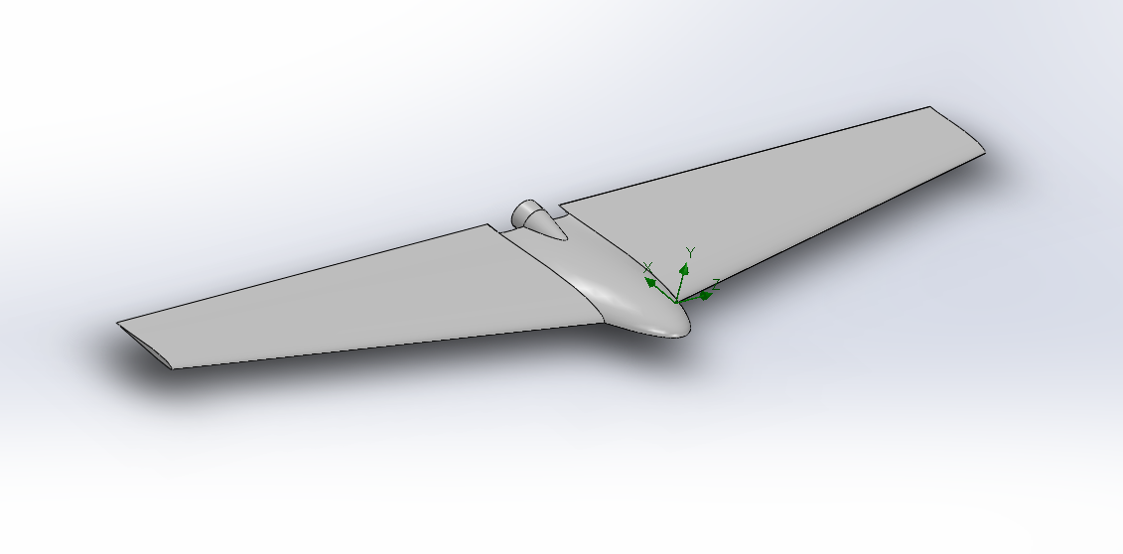
3D models and Simulations

Slide 5
Calculations
The estimated weight of the plane is 870g (with electronics weighing 500g).
Reynolds number: 1.1843e+5
Estimated lift: 3.305 N
Estimated static deflection : MAX - 30.34 mm

Slide 6
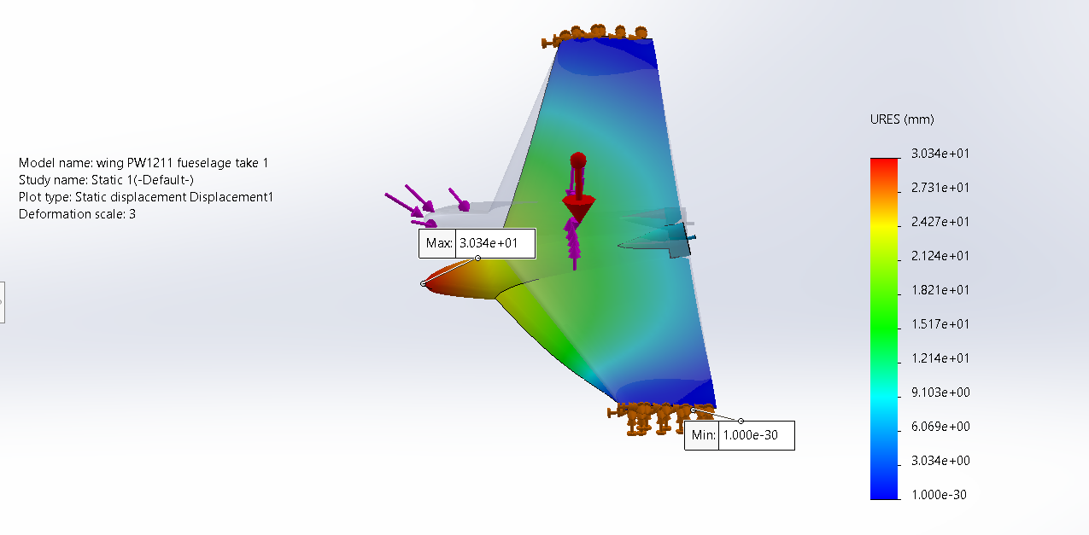
Static Deflection of UAV

Slide 7
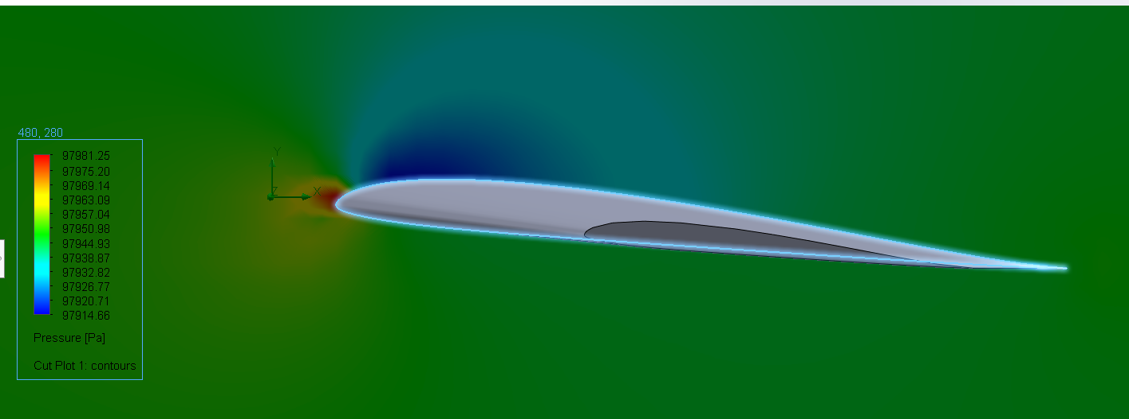
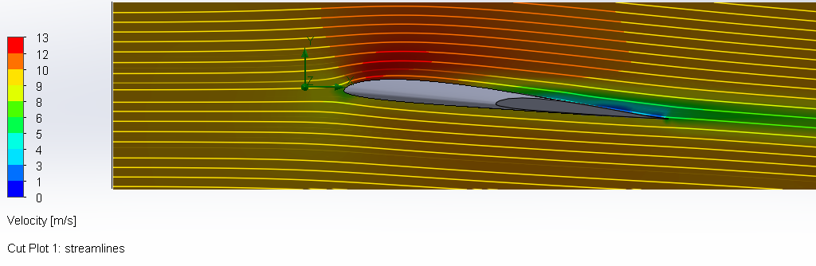
Wing Pressure Plot
Wing Velocity Plot

Slide 8
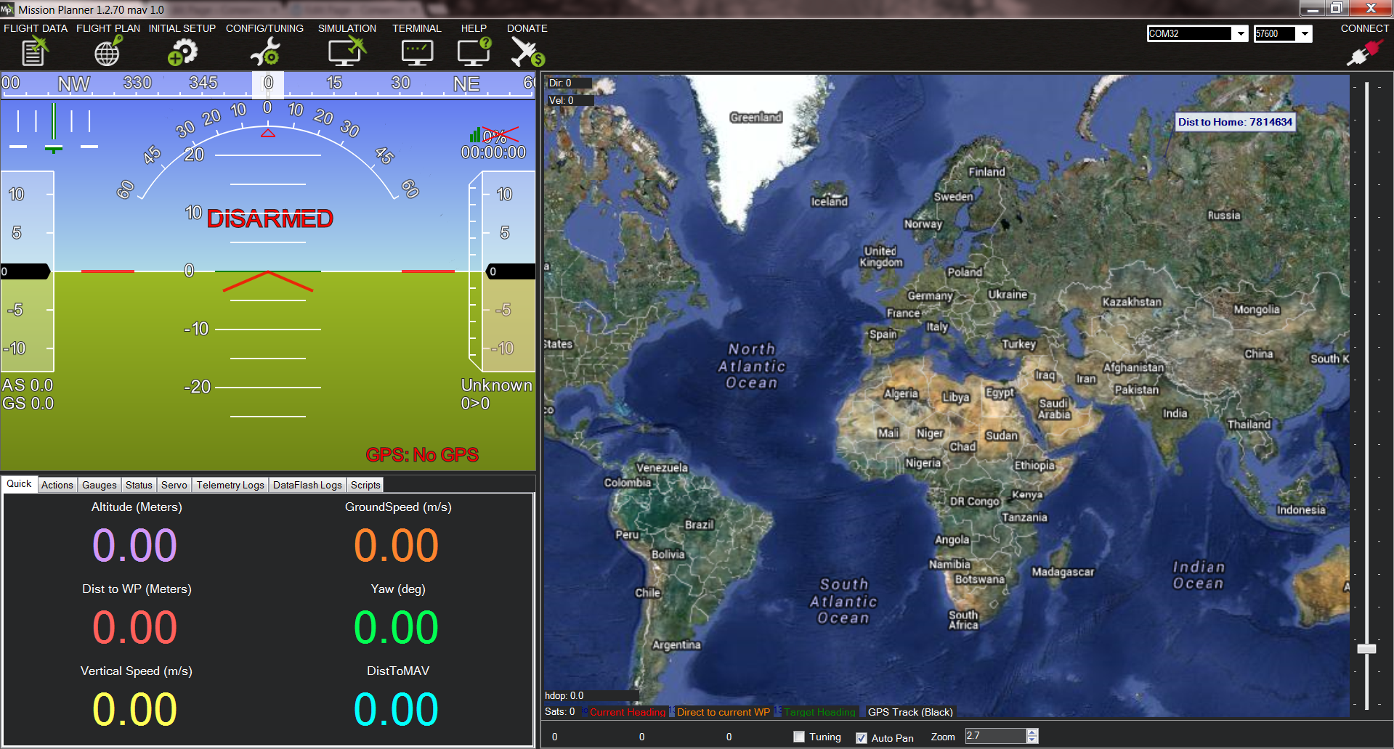
Software Used
Mission planner
ArduPilot

Slide 9
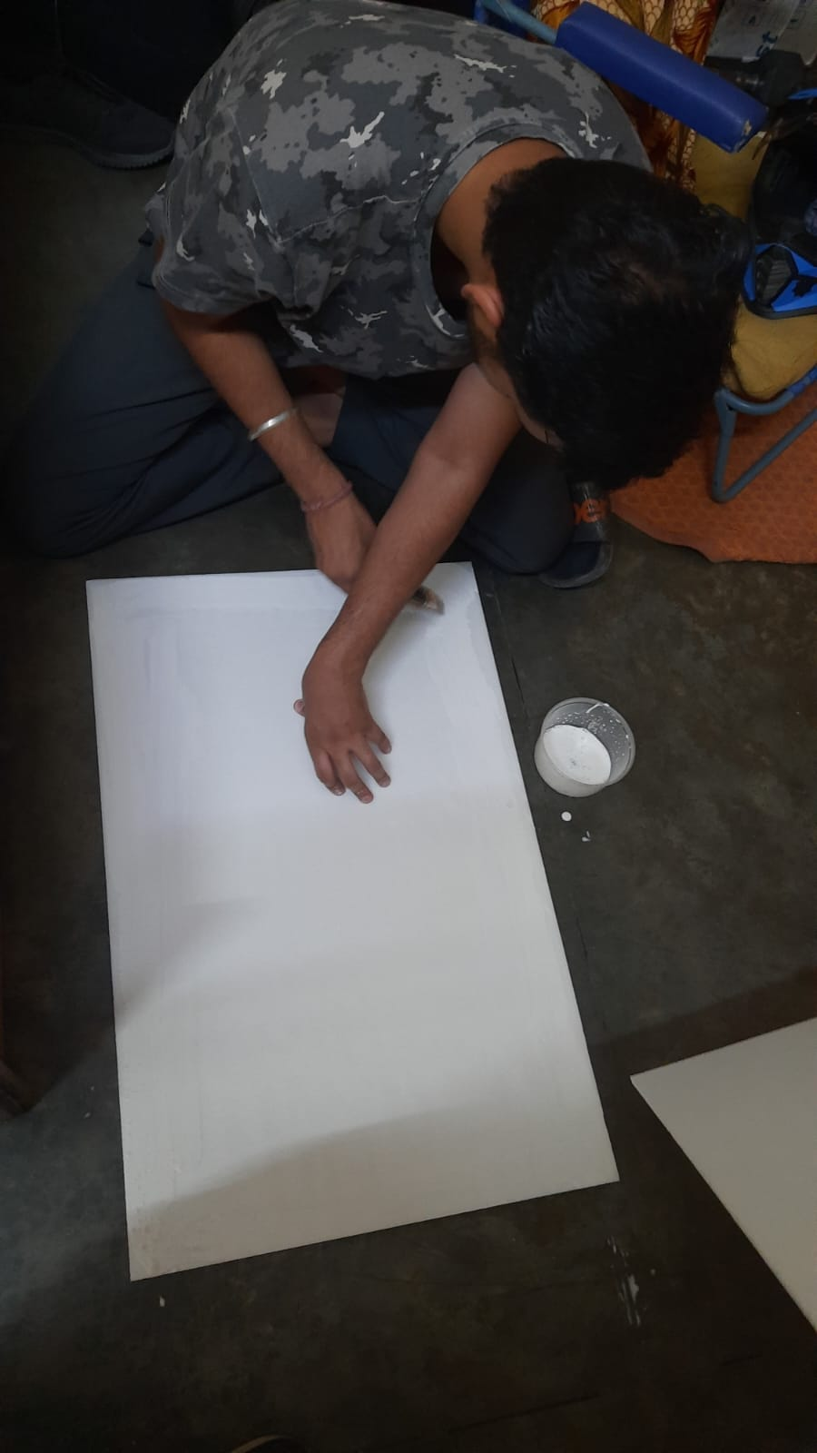
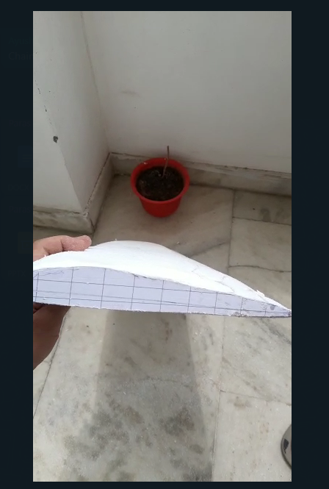
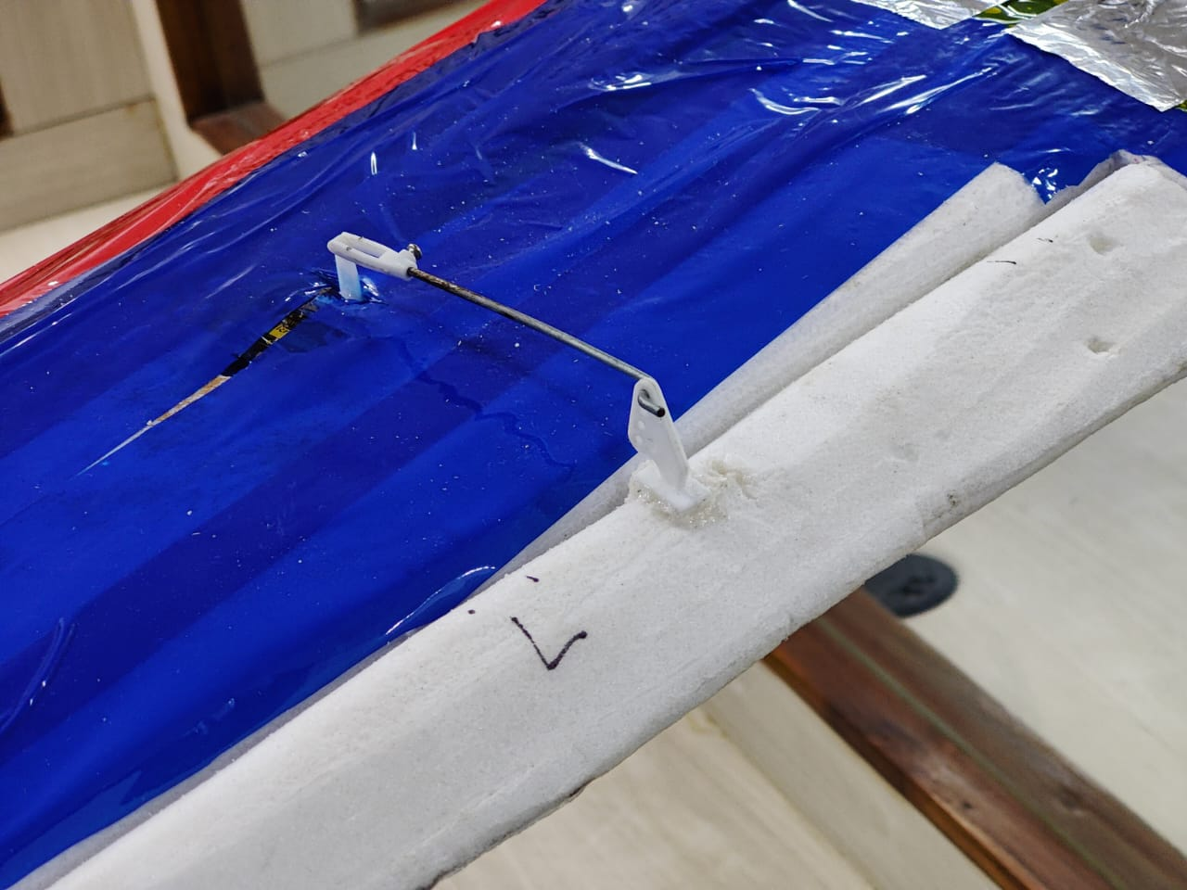
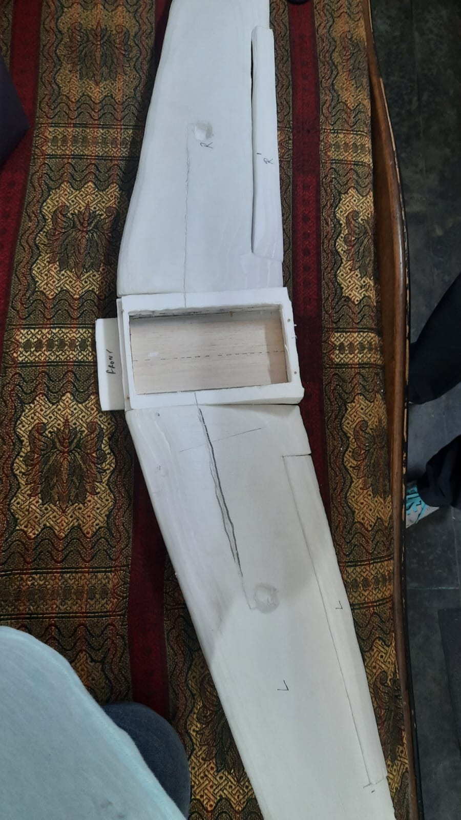
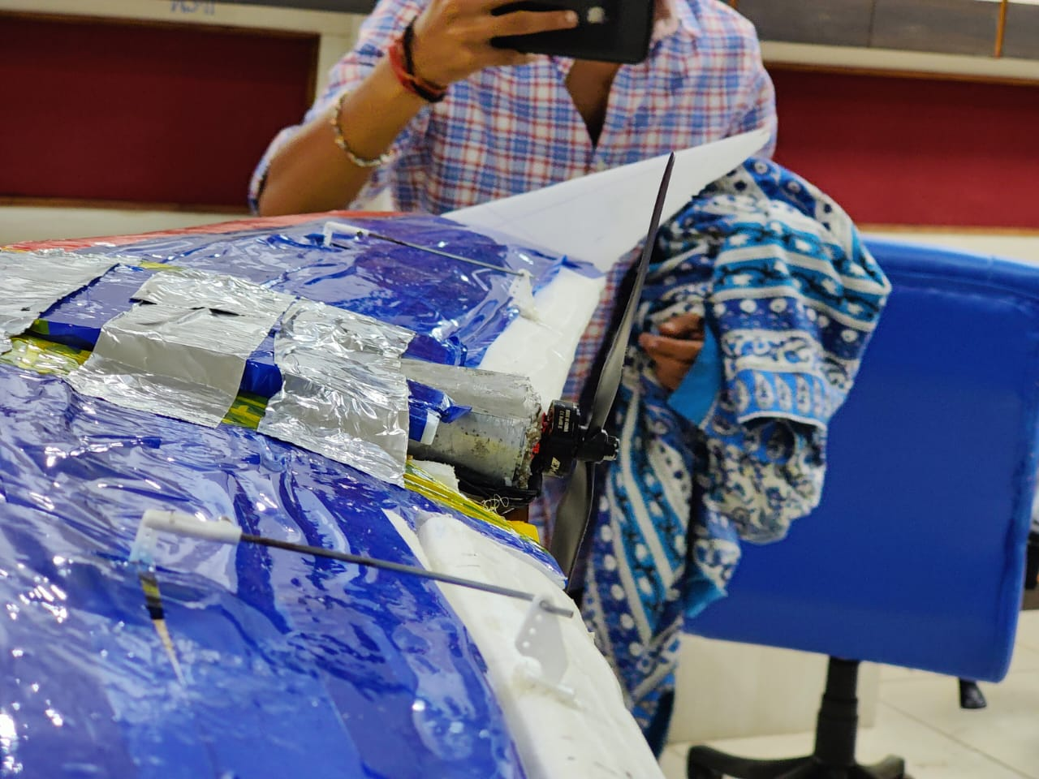
FABRICATION

Slide 10
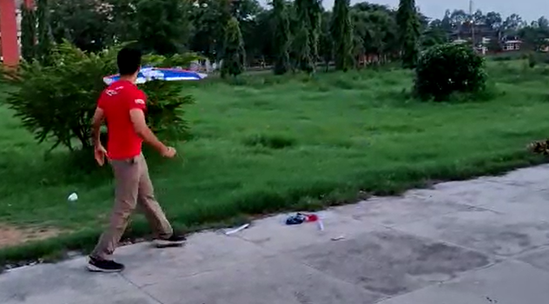
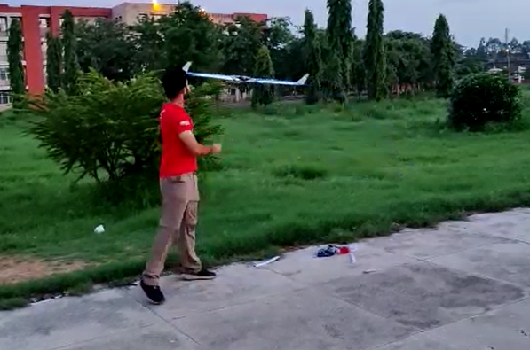
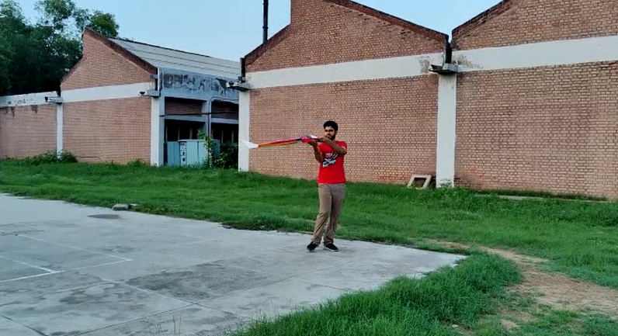
TESTING

Slide 11
Future Aspects :
Increasing Flight stability
Addition of Auto take off and auto land features
Installation of high resolution camera for various application
Use AI for object detection

Slide 12
THANK YOU

